Slide 1


FINAL YEAR PORJECT
NEWS MAVENS
Freelance Platform for Jouralists
Group Members
Usama Shafique(UET-40) Rameen Naveed(UET-42) Asjad Ullah(UET-31)
Supervised By
Engr Fahim Muhammad Khan

Slide 2


Contents
Introduction Problem Statement Aim And Objectives
Literature Review/existing systems Methodology
Tool/Experimental setup References

Slide 3
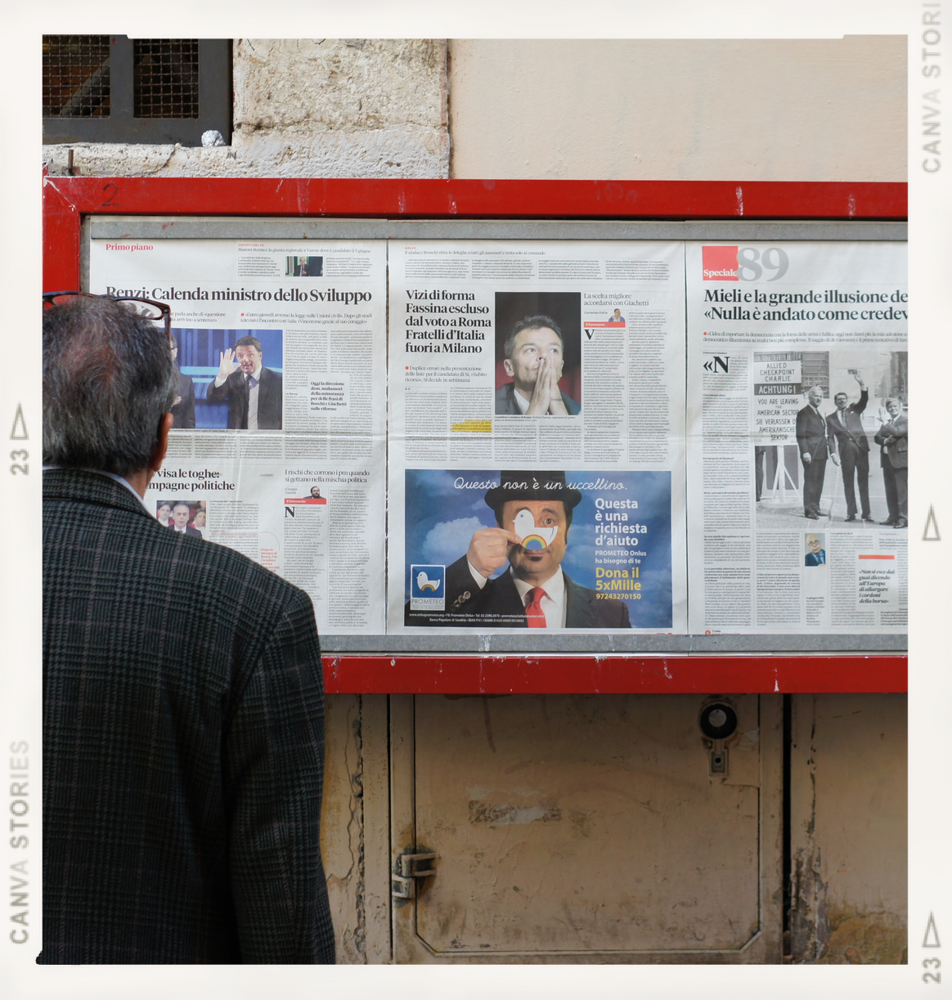
INTRODUCTION
News Mavens will be the first and best platform for everyone to keep themself up to date about daily news reports. Our platform will provide remote work for journalists as many big companies or media houses can hire them on remote basis work (small projects, contract basis).

Slide 4
PROBLEM STATEMENT
Job security is one of the most challenging aspects of being a journalist nowadays. People nowadays rely on social media news that isn't authenticated and doesn't have a reliable source.
Also media houses can't find the right person because of the market gap.
Many News agency requires journalist for single project but they have to hire them as there isn’t a proper channel for hiring journalist for single project remotely or on- site.
Our proposed solution will provide a platform where journalist will find Regular job opportunities in form of long term projects. Opportunities and to reduce the Job insecurity for journalists.
News Mavens will ensure to share resourceful daily news udate to the viewers on which they can rely

Slide 5

Aim :
To facilitate journalists to seek their jobs and to provide resourceful news to our viewers.
Objective :
To Help the Journalists community to find freelance remote work opportunities and to reduce the Job insecurity for journalists
To help the Media houses, News channels, and online newspaper companies to find the best journalist they need.
It helps to keep everyone up to date about news reports by providing an authentic and resourceful news

Slide 6

Literature Review
"In the phases of economic downturn, working journalists have always been affected by downsizing, termination, and layoff and cut in salaries as well as job- related issues which are heighting job related concerns in journalists working in the media industry. "[1]
Issues :
Job insecurity issues Salaries Issues
overburden on journalist and they work more then office working hours.

Slide 7
Literature Review
"Many have expressed concern about the effects of false stories ("fake news"), circulated largely through social media" [2]
"From a historical perspective, contemporary citizens have gained incomparable opportunities to access and contribute to news reporting". [3]
Issues :
Fake stories on social media to mislead people.
Just awarness about fake news issues and no proper solution to stop people from sharing or posting fake news
Social Media platforms and unknown News website major source of fake news Non-professional people have access to share news on social media and share news without checking credibility of it.

Slide 8
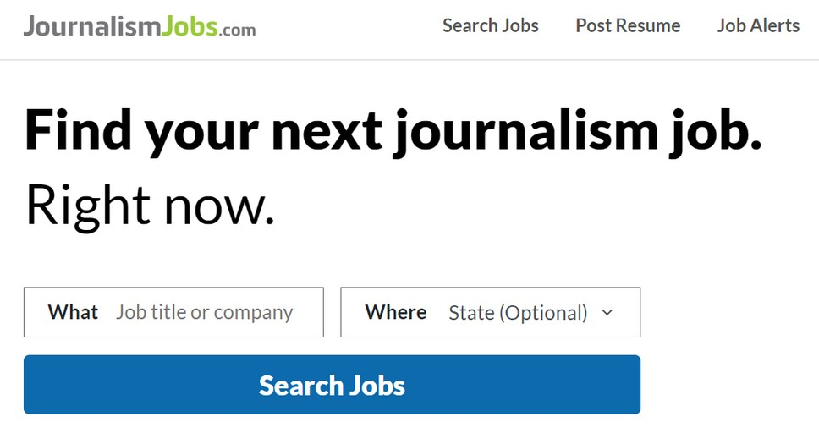

Existing Systems :
1: JournalismJobs.com
Job listing platform for journalists . They can find different kind of job listed there by News industry organization on journalismJobs.com and apply for it . Also journalist can share their resume on the platform .
Limitations :
Only job posting website with just "apply for" link doesn't have a suitable platform for journalist and News industry organizations
No communication between journalist and organizations.
resume displaying option, doesn't have portfolio feature for journalist to display their work and skills.

Slide 9

Existing Systems :
1: Contena
Contena is a premium freelance writing website that aims to be more than “just another job board.”
First, they have what they call their “writing job finder” that automatically collects the best freelance writing gigs from around the web.
Limitations :
Only for those journalist who are writers.
Paid
limited to just one serivce that they provide to News industry which is writing

Slide 10

Existing Systems :
1: UpWork
While the marketplace features freelance jobs of all sorts, there are plenty of freelance writing jobs available – from blogging to resume writing, website copywriting to technical documentation.
Limitations :
Not Specifically for journalists commonly used by writers
Highest fees for freelance writing sites
Can take a while to build your reputation on the platform

Slide 11

Proposed Systems :
1: News Mavens:
The platform we offer will give journalists access to regular employment prospects in the form of long-term projects. Opportunities and lowering journalist job insecurity The audience will receive insightful daily news updates from News Mavens that they can trust.
Features And Add-ons : :
Our platform allows journalists to work from anywhere.
Our platform enables media companies and news agencies to receive news reports from distant journalists in locations where they are unable to send staff members right away.
Our technology will enable viewers to get all types of news via a mobile app.

Slide 12
Existing Systems :
Existing
Systems
Contena JournalismJobs
.com
Upwork
Freelance
Pltform
Specialized
Platform
Daily Vast News
updates
Remote
Proposed System
News Mavens

Slide 13
PROPOSED METHOLOGY
Aglie Methodology
We are using agile methodology because our project is open-ended. It will require changes on a daily or maybe weekly basis so for that reason we prefer agile methodology
We have concluded that XP agile framework is most suitable for our project from time perspective. Following are other main aspects of XP;
cost effective simplicity high visibility feedback

Slide 14
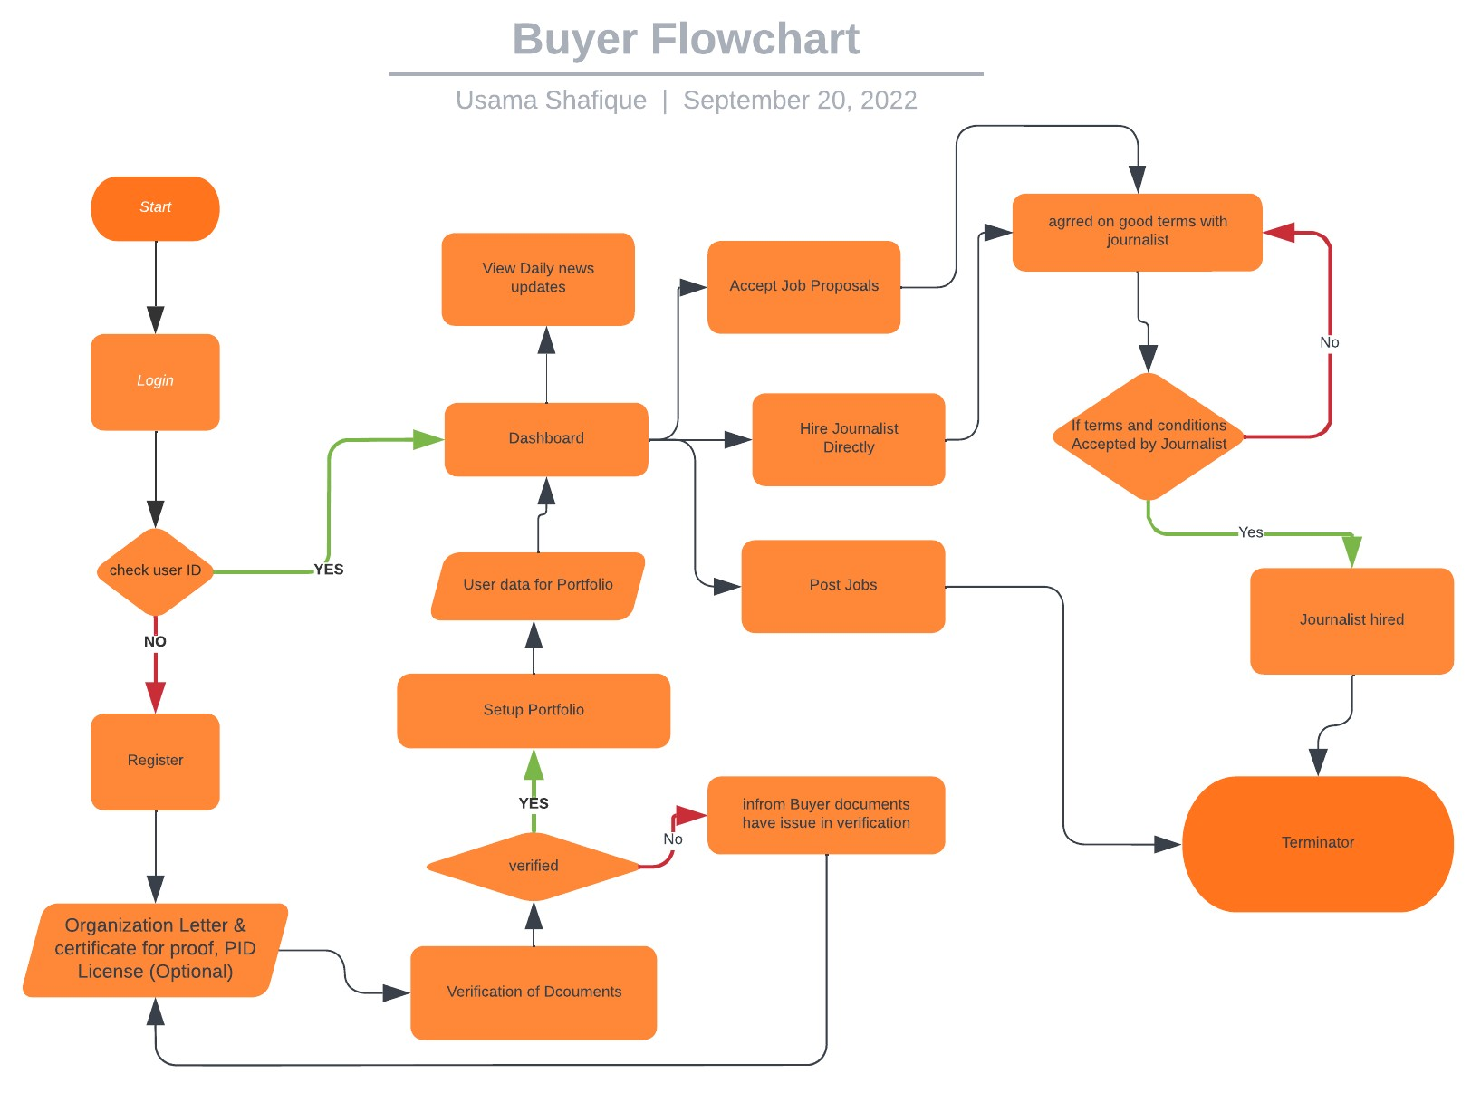

Slide 15
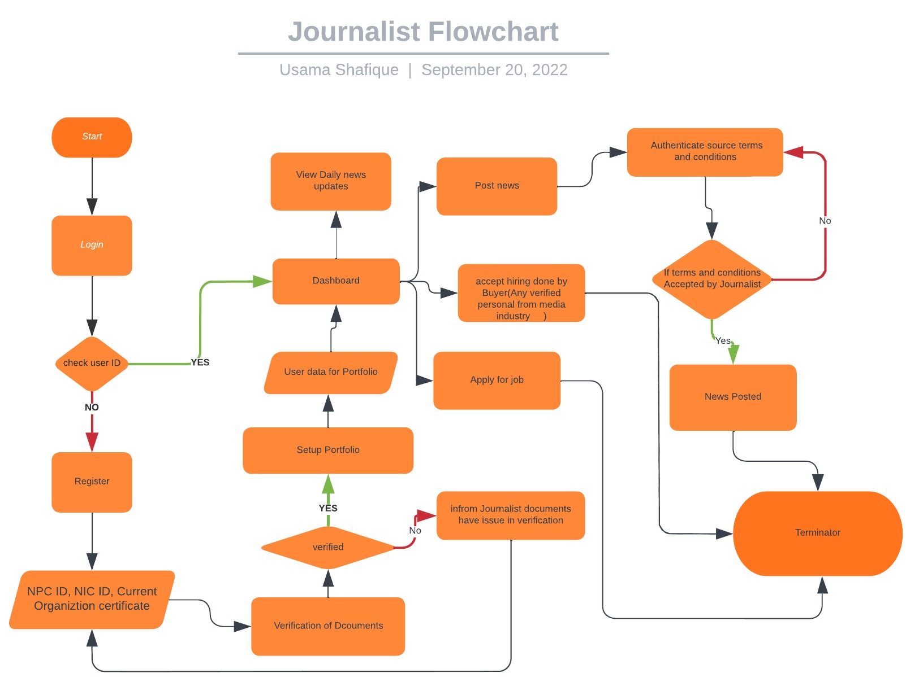

Slide 16
Tools/Experimental Setup
Frontend
HTML
CSS JS
Bootstrap
React
React Native Webpack
Backend
ExpressJS
NodeJS
SEO Tool
Google Analytics Google Search Console Ahrefs
Product Analytic Tool
Heap.io
google Workspace
server
Firebase
Realm
Cloudflare server Cludfare CDN
Nginx (Work as reverse proxy) Git
Github
Testing tool
Appium Acunetix
WebLoad ( stress testing tool)

Slide 17
References
Ashraf, A., Tayyib, M., Awais, M., & Ali, F. (2020). Effects of job insecurity on media professionals of Pakistan. Journal of Organizational Culture, Communications and Conflict, 24, 1-15.
Westlund, O. (2013). Mobile news: A review and model of journalism in an age of mobile media. Digital journalism, 1(1), 6-26.
Allcott, H., & Gentzkow, M. (2017). Social media and fake news in the 2016 election. Journal of economic perspectives, 31(2), 211-36.

Slide 18
Q & A

Slide 19
THANK YOU

